Slide 1

Product
Overview

Slide 2
Agenda
Architecture
Product Features
Why Shining Bot?
Contact details

Slide 3
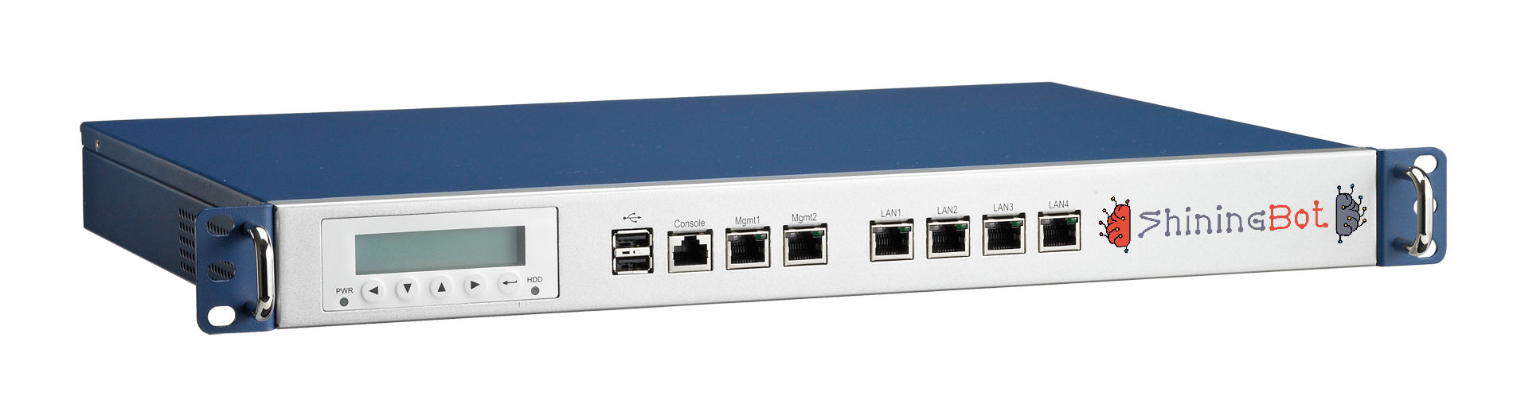
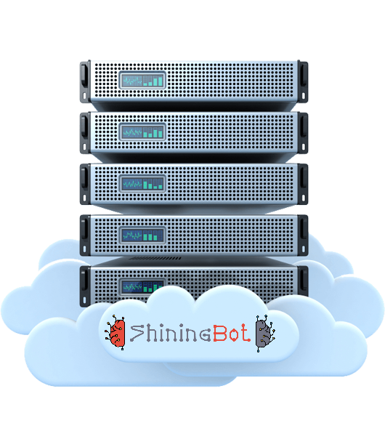


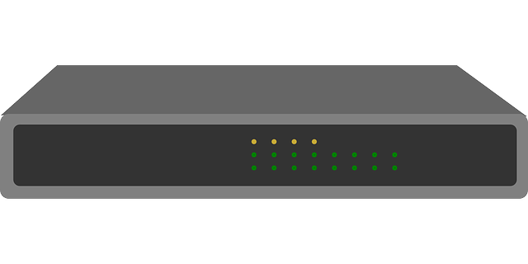
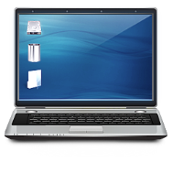
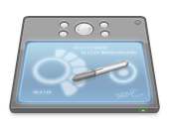

Hardware Architecture
Internet
Access Point
Wireless Controller (Optional)
Server (Optional)
Wireless Clients (Laptop/Tab/Mobile)
Shining Bot Cloud Infrastructure
Customer in-premises Infrastructure

Slide 4









How Shining Bot works …
Customer
Registration
Check-In
Sign-In
Customer Database
Internet
Usage
Customer
Data Source
Feedback Management
Feedback
Data
Self-Service
Solution
Marketing by
SMS / WhatsApp / Email

Slide 5

Product Features
Feedback
Self Service
Collect feedback from
your customer using
Simple QR Code
Manage In-Room Dining &
amenities delivery using QR Code & Mobile browser
Authentication
API Service
Authenticate users with complete control & Manages logs as per Industry Standard
Seamlessly integrate with your PMS Software for automatic guest management

Slide 6

Authentication & Log Management
In built user registration with validation
Password delivery by SMS (OTP)
User authentication & Tracking
Bandwidth control (Speed & Download limit)
Concurrent access control
Log as per Industry Standard
Log retention for 18 months as per norms
Investigation support for violations
API connectors to PMS or external source

Slide 7
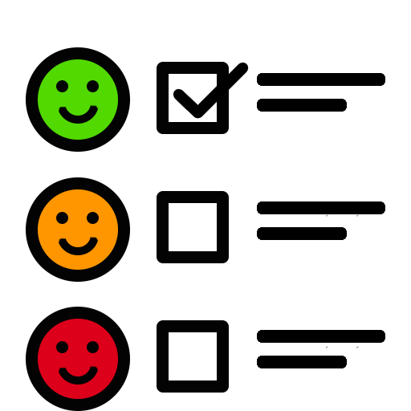
Feedback Management
Login/Logout/Status page provides feedback link
Customizable feedback forms
Complete feedback reports in dashboard
AI based automatic sentiment analysis
Escalate to next level based on threshold
Follow the customer with short URL
Optional feature to share escalation matrix
Compare various feedback by same user
Generates KPI reports based on feedback

Slide 8
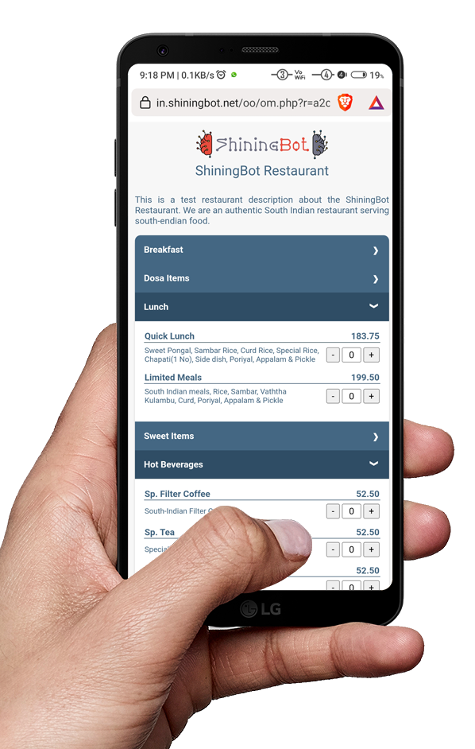
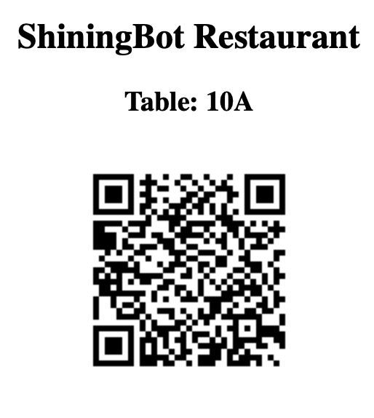
Self Service Menu, Order & KOT printing
Manage Restaurant, Room Service & Amenities supply using self-service system
Easily generate Room-wise/Table-wise QR Code
User can scan QR code / No need to install any APP
Menu items show based on the availability time
Provision to disable items from display
Immediately prints KOT on confirmation by user
Saves man-power in order taking and communication errors

Slide 9

Application Programming Interface
Shining Bot provides API, that can connect to:
  Most industry leading PMS solutions
  Most industry leading Database Management Systems
We can also customize our interface to connect to your proprietary software
We also provide API to customize your development based on the Shining Bot platform
API services are custom designed for the individual requirement, talk to Shining Bot solution expert for more information

Slide 10

Why Shining Bot …
Exploit the power of Ai & Machine Learning technology for your business development
Provides complete insights about business and operation using WiFi
State of the art solution to improve the business process & profits
Explore the hidden data in your business to exploit the opportunities
It follows your customer even outside your business premises
Increases customer satisfaction by enhancing the experience

Slide 11

ShiningBot Data Analytics (P) Limited
F3 – Nathigam Building, 97/55, NSK Salai (Arcot Road), Kodambakkam, Chennai – 600 024, TN, India
www.shiningbot.com | info@shiningbot.com
a product of ShiningBot

